Slide 1
Expert System
By: Ashok Basnet

Slide 2
Course Outline
Introduction
Expert System, Feature, Characteristics, Development, Architecture
Goal and Basic Activities and Advantages
Stages in the Development of an Expert System
Probability-Based Expert System
Expert System Tools

Slide 3
What is an expert system?
An expert system is a computer program or software designed to mimic the decision-making abilities of a human expert in a specific domain or field.
It is a type of artificial intelligence (AI) technology that uses a knowledge base, which contains facts and rules about a particular subject, to provide advice, make decisions, or solve problems.
Expert systems are developed by capturing the knowledge and expertise of human specialists and encoding it into a computer system.
The knowledge base typically consists of a set of rules or if-then statements that represent the expert's knowledge and reasoning process.
These rules are used to infer conclusions or recommendations based on the given input or data.

Slide 4
What is an expert system?
When a user interacts with an expert system, they provide information or answer questions related to the specific problem or domain.
The system then applies the rules and uses its inference engine to analyze the input and provide a solution or recommendation.
The output of an expert system can be in the form of textual explanations, suggestions, or even actions.
Expert systems have been successfully used in various domains, including medicine, finance, engineering, and troubleshooting complex technical systems.

Slide 5
What is an expert system?
They are particularly valuable in situations where human expertise is scarce, expensive, or difficult to access.
Expert systems can help in knowledge transfer, decision support, problem-solving, and training.
It's important to note that while expert systems can be highly effective within their specific domain, they are limited to the knowledge encoded within their knowledge base.
They do not possess general intelligence or the ability to learn and adapt outside of their predefined rules and knowledge.

Slide 6
EXPERT SYSTEM
Use of expert systems is specially recommended when:
Human experts are difficult to find
Human experts are expensive
Knowledge improvement is important
The available information is poor, partial, incomplete
Problems are incompletely defined
There is lack of knowledge among all those who need it
The problem is rapidly changing legal rules and codes
Expert systems provide the following important features:
Facility for non-expert personnel to solve problems that require some expertise
Speedy solution
Reliable solution
Cost reduction
Power to manage without human experts
Wider areas of knowledge

Slide 7
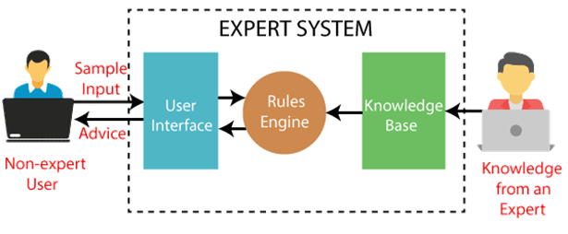

Slide 8
FEATURES
We can represent knowledge in terms of Rules and Objects
Knowledge is represented in IF-THEN rules
EX: IF it is raining, THEN carry an umbrella , here the Knowledge Base (KB) consists of the fact that it is raining, it will match the condition of rule and upon whose satisfaction we conclude that we need to carry an umbrella
We can built many significant expert system by expressing the knowledge of the expert in the form of rules. Rules can be Pattern-Match on objects well as fact.
KB Expert system encompasses following entities:
Knowledge Engineer: Human with background of computer science and AI
Domain Expert
Human Expert

Slide 9
Characteristics of Expert System
High Performance: The expert system provides high performance for solving any type of complex problem of a specific domain with high efficiency and accuracy.
Understandable: It responds in a way that can be easily understandable by the user. It can take input in human language and provides the output in the same way.
Reliable: It is much reliable for generating an efficient and accurate output.
Highly responsive: ES provides the result for any complex query within a very short period of time.

Slide 10
Components of Expert System
User Interface
Inference Engine
Knowledge Base

Slide 11
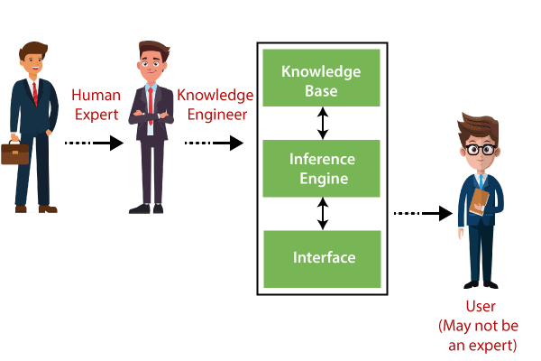

Slide 12
User Interface
With the help of a user interface, the expert system interacts with the user, takes queries as an input in a readable format, and passes it to the inference engine.
After getting the response from the inference engine, it displays the output to the user.
In other words, it is an interface that helps a non-expert user to communicate with the expert system to find a solution.

Slide 13
Inference Engine(Rules of Engine)
The inference engine is known as the brain of the expert system as it is the main processing unit of the system.
It applies inference rules to the knowledge base to derive a conclusion or deduce new information.
It helps in deriving an error-free solution of queries asked by the user.
With the help of an inference engine, the system extracts the knowledge from the knowledge base.

Slide 14
Inference Engine(Rules of Engine)
There are two types of inference engine:
Deterministic Inference engine: The conclusions drawn from this type of inference engine are assumed to be true. It is based on facts and rules.
Probabilistic Inference engine: This type of inference engine contains uncertainty in conclusions, and based on the probability.
Inference engine uses the below modes to derive the solutions:
Forward Chaining: It starts from the known facts and rules, and applies the inference rules to add their conclusion to the known facts.
Backward Chaining: It is a backward reasoning method that starts from the goal and works backward to prove the known facts.

Slide 15
Knowledge Base
The knowledge base is a type of storage that stores knowledge acquired from the different experts of the particular domain.
It is considered as big storage of knowledge. The more the knowledge base, the more precise will be the Expert System.
It is similar to a database that contains information and rules of a particular domain or subject.
One can also view the knowledge base as collections of objects and their attributes.
Such as a Lion is an object and its attributes are it is a mammal, it is not a domestic animal, etc.

Slide 16
Knowledge Base
Components of Knowledge Base
Factual Knowledge: The knowledge which is based on facts and accepted by knowledge engineers comes under factual knowledge.
Heuristic Knowledge: This knowledge is based on practice, the ability to guess, evaluation, and experiences.
Knowledge Representation: It is used to formalize the knowledge stored in the knowledge base using the If-else rules.
Knowledge Acquisitions: It is the process of extracting, organizing, and structuring the domain knowledge, specifying the rules to acquire the knowledge from various experts, and store that knowledge into the knowledge base.

Slide 17
Development of Expert System
Here, we will explain the working of an expert system by taking an example of MYCINES. Below are some steps to build an MYCIN:
Firstly, ES should be fed with expert knowledge. In the case of MYCIN, human experts specialized in the medical field of bacterial infection, provide information about the causes, symptoms, and other knowledge in that domain.
The KB of the MYCIN is updated successfully. In order to test it, the doctor provides a new problem to it.
The problem is to identify the presence of the bacteria by inputting the details of a patient, including the symptoms, current condition, and medical history.

Slide 18
Development of Expert System
The ES will need a questionnaire to be filled by the patient to know the general information about the patient, such as gender, age, etc.
Now the system has collected all the information, so it will find the solution for the problem by applying if-then rules using the inference engine and using the facts stored within the KB.
In the end, it will provide a response to the patient by using the user interface.

Slide 19
Participants in the development of Expert System
There are three primary participants in the building of Expert System:
Expert: The success of an ES much depends on the knowledge provided by human experts. These experts are those persons who are specialized in that specific domain.
Knowledge Engineer: Knowledge engineer is the person who gathers the knowledge from the domain experts and then codifies that knowledge to the system according to the formalism.
End-User: This is a particular person or a group of people who may not be experts, and working on the expert system needs the solution or advice for his queries, which are complex.

Slide 20
PROBABILITY BASED EXPERT SYSTEM
A probability-based expert system, also known as a probabilistic expert system, is an extension of traditional expert systems that incorporates probabilistic reasoning and uncertainty management into the decision-making process.
While conventional expert systems operate on deterministic rules, probability-based expert systems handle situations where uncertainty and incomplete information are present.
In a probability-based expert system, the knowledge base includes not only rules but also probabilities associated with those rules.
These probabilities represent the likelihood or degree of belief in the occurrence or validity of a particular rule or conclusion.
By combining these probabilities with input data, the system can compute the likelihood of different outcomes and make decisions based on the probabilities.

Slide 21
PROBABILITY BASED EXPERT SYSTEM
One popular approach used in probability-based expert systems is Bayesian networks.
Bayesian networks model relationships between variables using directed acyclic graphs, where nodes represent variables and edges represent probabilistic dependencies.
The network allows for inference and updating of probabilities based on new evidence or observations.
The advantages of probability-based expert systems include the ability to handle uncertain or incomplete data, account for conflicting evidence, and provide probabilistic explanations or recommendations.
They can be particularly useful in domains such as medical diagnosis, risk assessment, decision analysis, and fault detection, where uncertainty is prevalent and where the ability to reason with probabilities is crucial.

Slide 22
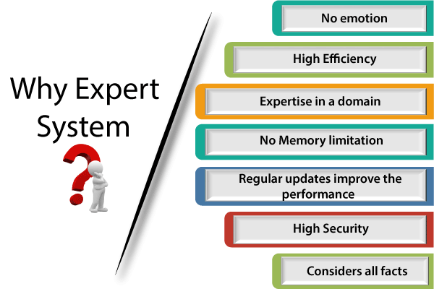

Slide 23
Advantages of Expert System
These systems are highly reproducible.
They can be used for risky places where the human presence is not safe.
Error possibilities are less if the KB contains correct knowledge.
The performance of these systems remains steady as it is not affected by emotions, tension, or fatigue.
They provide a very high speed to respond to a particular query.

Slide 24
Limitations of Expert System
The response of the expert system may get wrong if the knowledge base contains the wrong information.
Like a human being, it cannot produce a creative output for different scenarios.
Its maintenance and development costs are very high.
Knowledge acquisition for designing is much difficult.
For each domain, we require a specific ES, which is one of the big limitations.
It cannot learn from itself and hence requires manual updates.

Slide 25
Applications of Expert System
In designing and manufacturing domain: It can be broadly used for designing and manufacturing physical devices such as camera lenses and automobiles.
In the knowledge domain: These systems are primarily used for publishing the relevant knowledge to the users. The two popular ES used for this domain is an advisor and a tax advisor.
In the finance domain: In the finance industries, it is used to detect any type of possible fraud, suspicious activity, and advise bankers that if they should provide loans for business or not.
In the diagnosis and troubleshooting of devices: In medical diagnosis, the ES system is used, and it was the first area where these systems were used.
Planning and Scheduling: The expert systems can also be used for planning and scheduling some particular tasks for achieving the goal of that task.

Slide 26
Expert System Tools
DENDRAL: It was an artificial intelligence project that was made as a chemical analysis expert system. It was used in organic chemistry to detect unknown organic molecules with the help of their mass spectra and knowledge base of chemistry.
MYCIN: It was one of the earliest backward chaining expert systems that was designed to find the bacteria causing infections like bacteraemia and meningitis. It was also used for the recommendation of antibiotics and the diagnosis of blood clotting diseases.
PXDES: It is an expert system that is used to determine the type and level of lung cancer. To determine the disease, it takes a picture from the upper body, which looks like the shadow. This shadow identifies the type and degree of harm.
CaDeT: The CaDet expert system is a diagnostic support system that can detect cancer at early stages.

Slide 27

Thank You

